Slide 1
Chapter 5
1

Slide 2
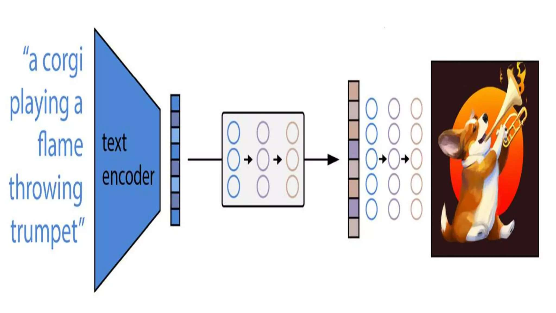

Slide 3
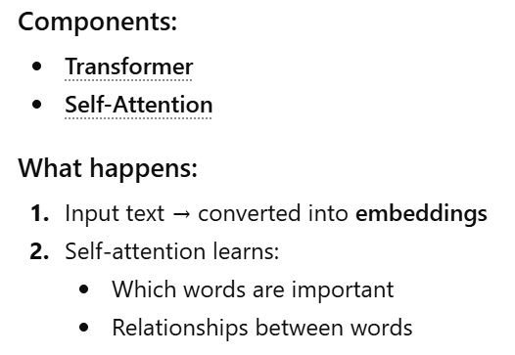
1. Text Understanding (Transformer + Self-Attention)

Slide 4
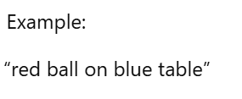


2. Image Generation : Diffusion Models

Slide 5



Slide 6
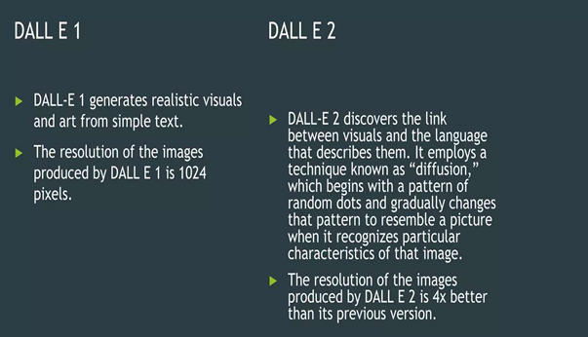

Slide 7
